Slide 1
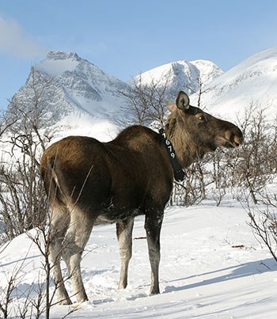


Moose Activity and Habitat Selection during Extreme Weather Events
GRS Msc Thesis Project, Niels van der Vegt, 1163116
Wageningen University
Supervisor: Sytze de Bruin
Swedish University of Agricultural Sciences
Dep. of Wildlife, Fish, and Environmental Studies (Umeå)
Supervisor: Wiebke Neumann

Slide 2
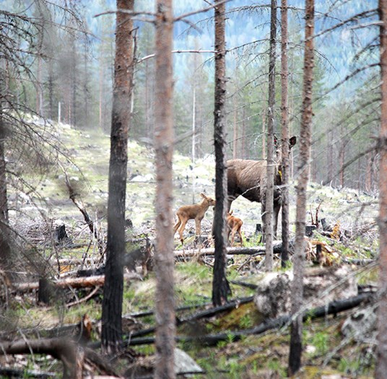
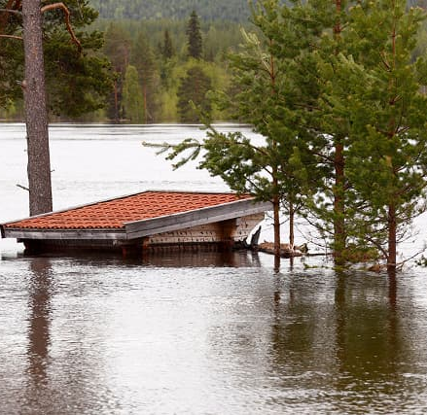
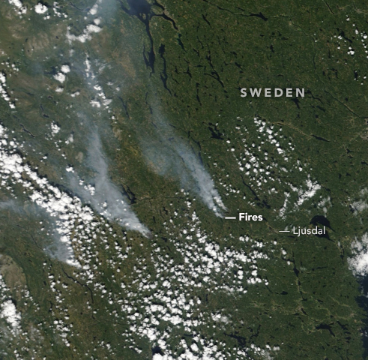
Climate Change, Extreme Weather, and Moose
Extreme weather, fires, floods, and droughts have increased in both frequency and intensity over the last 50 years (IPBES, 2019)
Prove a challenge for an organism’s ability to adapt (Gutschick and Bassirirad, 2010)
Sometimes the mechanistic drivers behind long-term biotic changes (Parmesan et al., 2000)
Credit Photos Grahame Soden (left), Fredrik Stenbacka (middle), NASA (right)
Notes:
Extreme weather, fires, floods, and droughts have increased in both frequency and intensity over the last 50 years (IPBES, 2019)
Prove a challenge for an organism’s ability to adapt (Gutschick and Bassirirad, 2010)
Proposed to be mechanistic drivers for long-term biotic changes e.g. range shifts (Parmesan et al., 2000)
The challenges faced (stress, death, etc.) during these rare events caused strong responses in population number, range shift, behaviour etc.

Slide 3
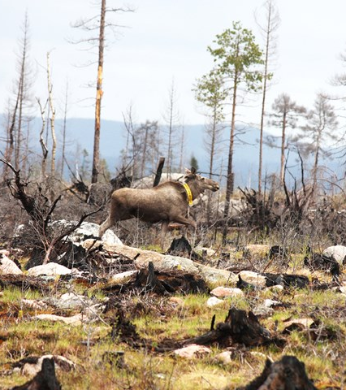
Research Need
Swedish moose are facing challenges
Reduced population numbers
Reduced offspring, calves weigh less (especially after dry, hot springs)
Large scale habitat alteration due to forest fires, floods
Investigating the mechanisms could help us make informed management decisions
Alter hunting policy after extreme events to reduce pressure
Consider altered wildlife habitat needs in landscape planning
Credit Photo: Fredrik Stenbacka
Notes:
gradual biological changes are linked to responses to extreme weather and climate events
Gain further understanding of the mechanisms behind extreme weather and an animal’s ability to adapt would allow us to make better climate impact predicions and respond with management decision.
We’d like to know if moose react to extreme weather events by changing their habitat or movement?
Covering all possible types of events would be out of the scope for this thesis, but we want to provide a methodological framework and test it with some hypothesis
predict climate impacts more accurately and

Slide 4
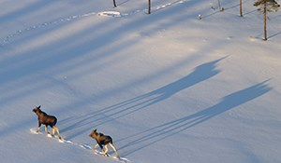
Research Aim
We’ll look at movement and habitat selection during extreme weather and compare them to usual weather
Considering 4 hypotheses, large amount of interaction effects challenging
Aim to create a methodology and codebase that can easily analyze other covariates
Credit Photo: Eric Andersson

Slide 5
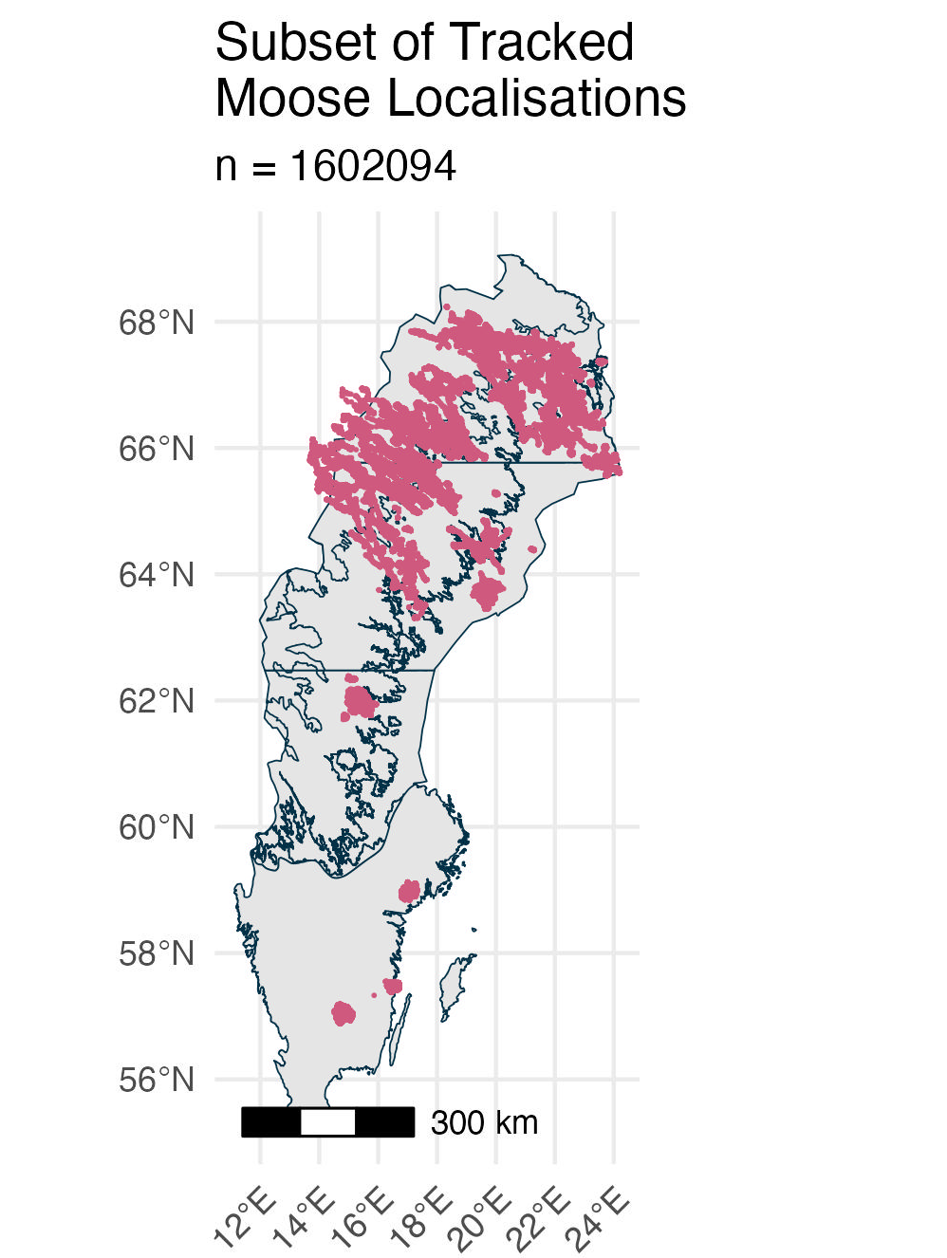
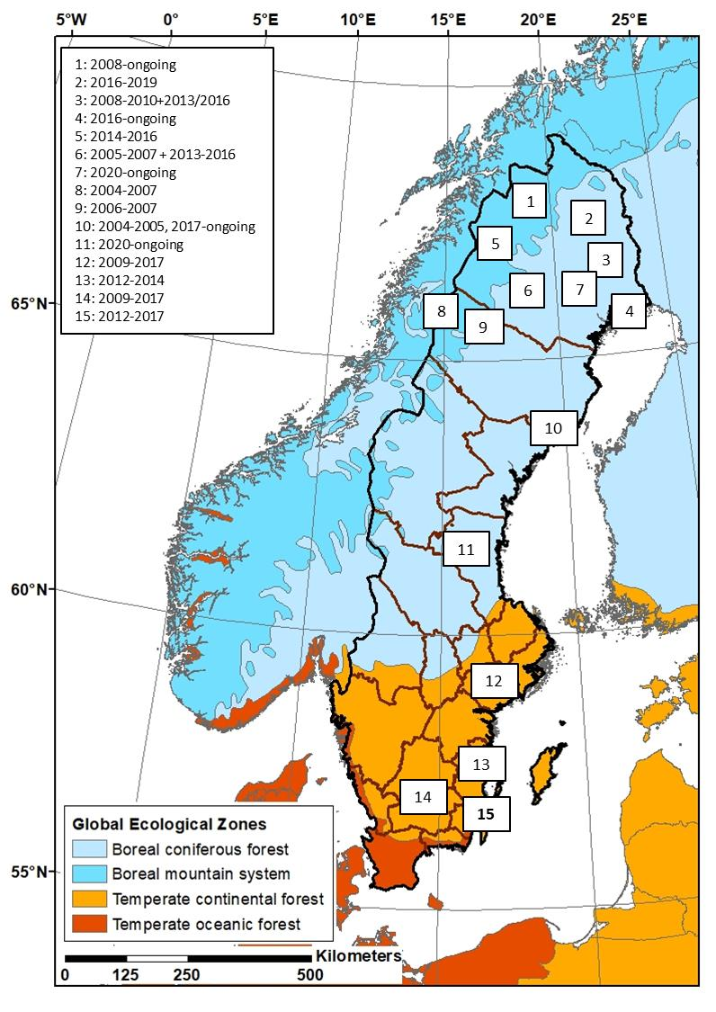
Moose Tracking
Data collected since 2003 across Sweden
Location every 3 hours using satallite GPS
Won’t analyse all data
Not during rutting season (early October) or migration (April & May) due to extreme changes in habitat usage
1.602.094 total localisations for 718 individuals
Average time tracked will differ

Slide 6
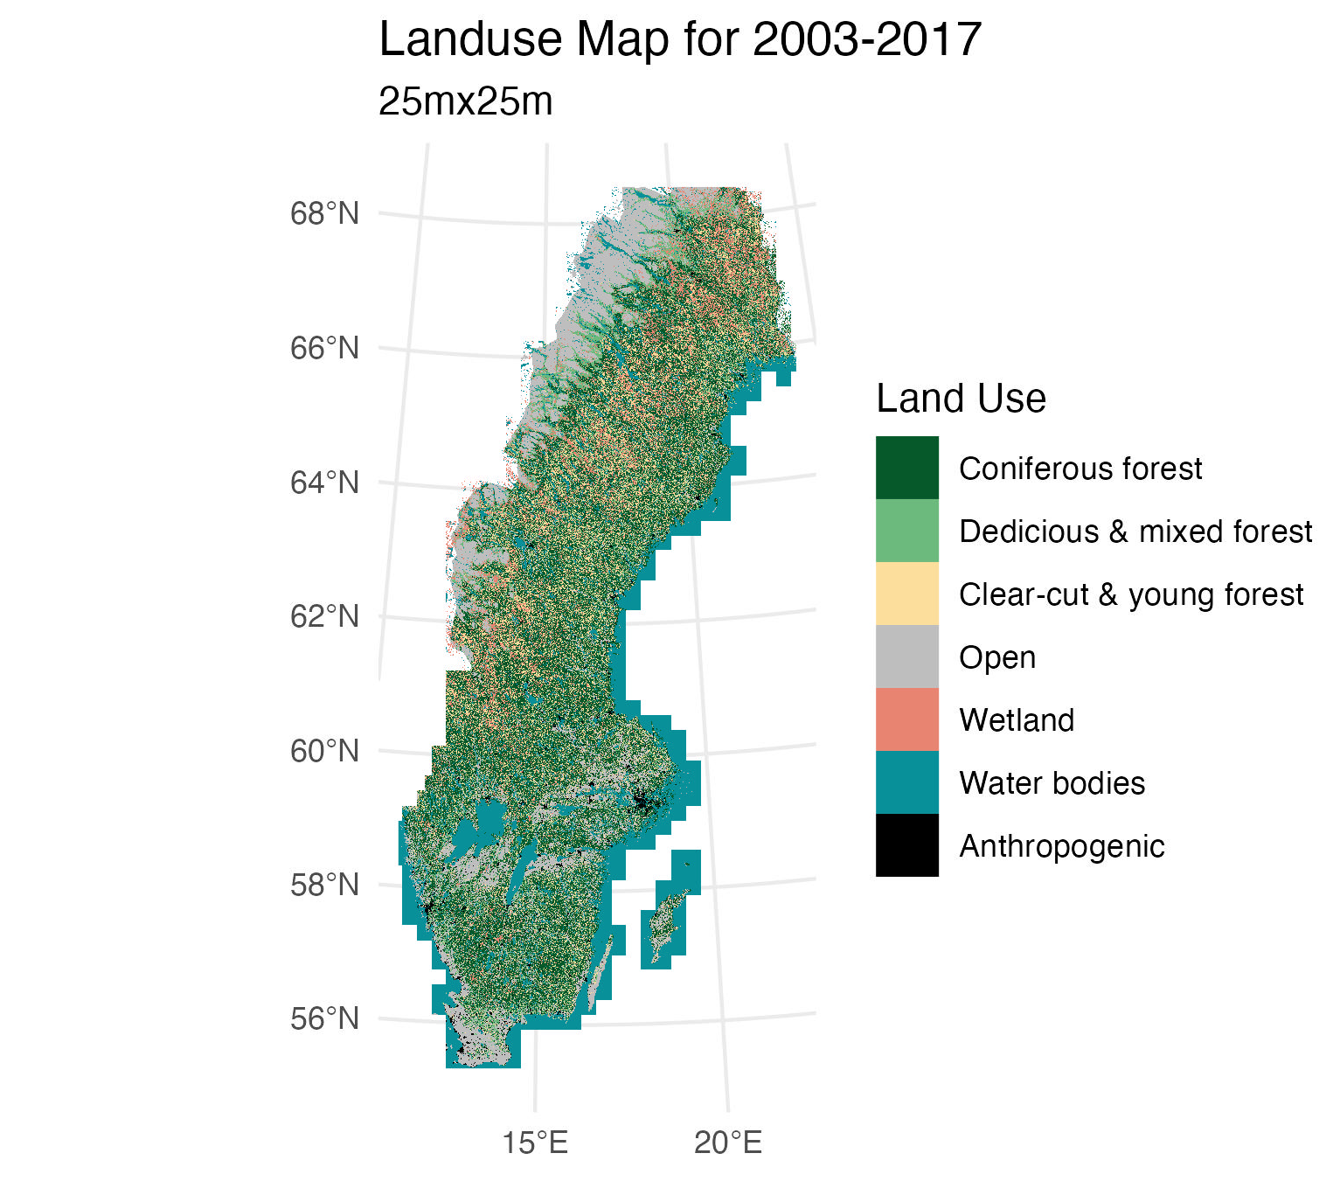
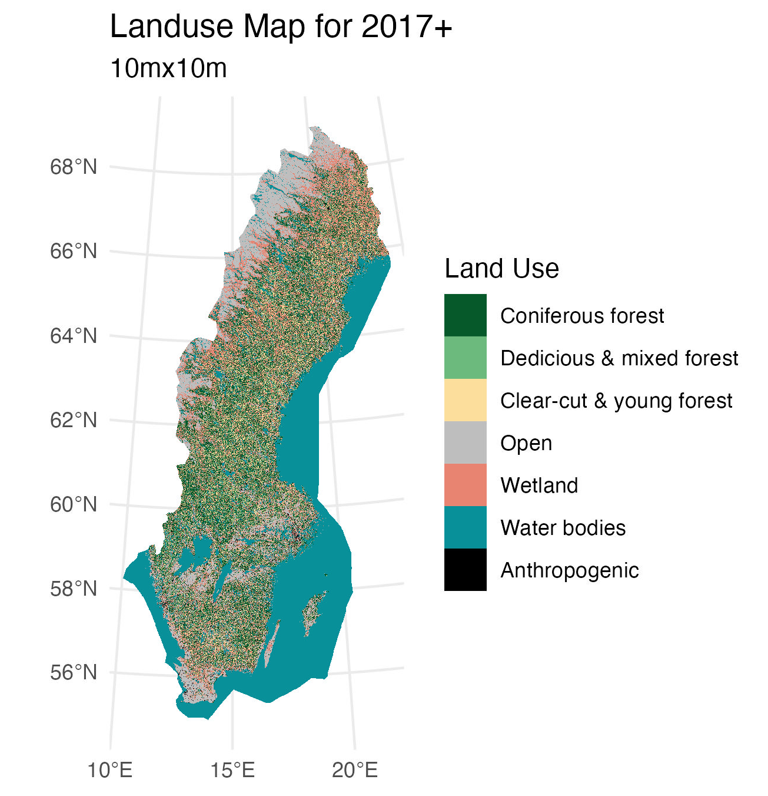
Land Use / Terrain Data
Two land use maps
2003-2017 (25x25m)
2017 + (10x10m)
Both manually updated with clear cut data
Ruggedness (50x50m) (Riley et al., 1999)

Slide 7
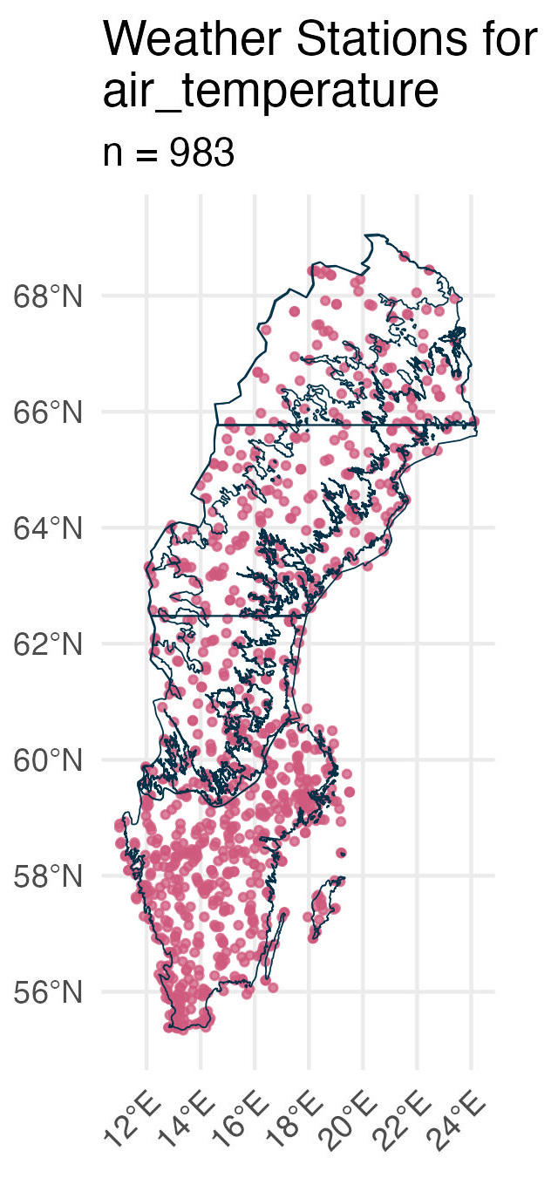
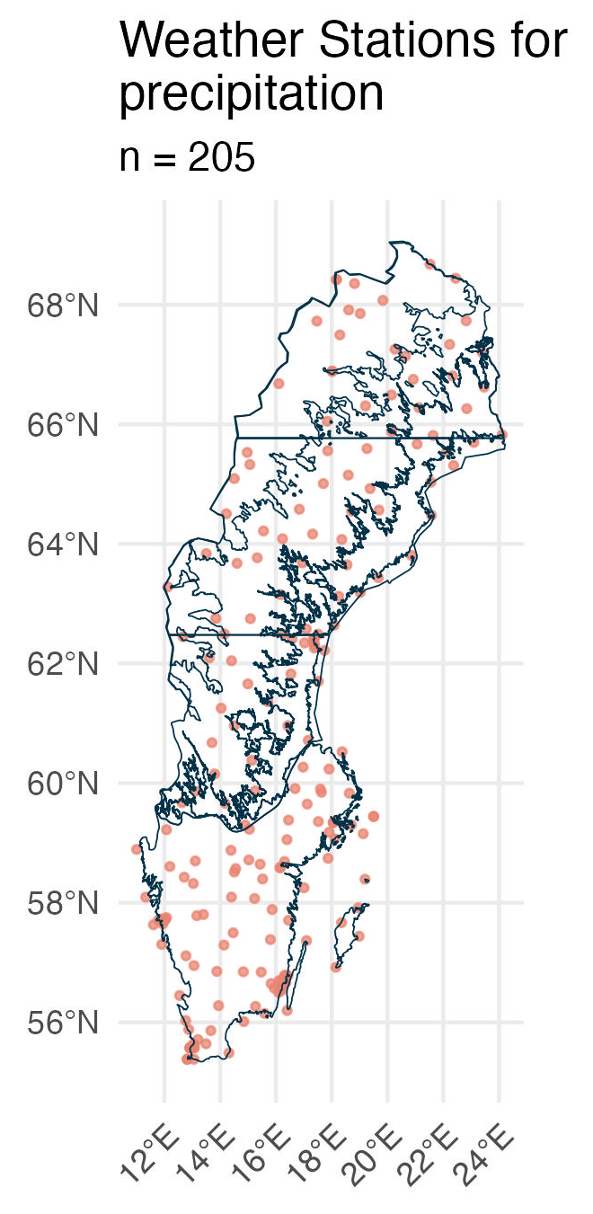
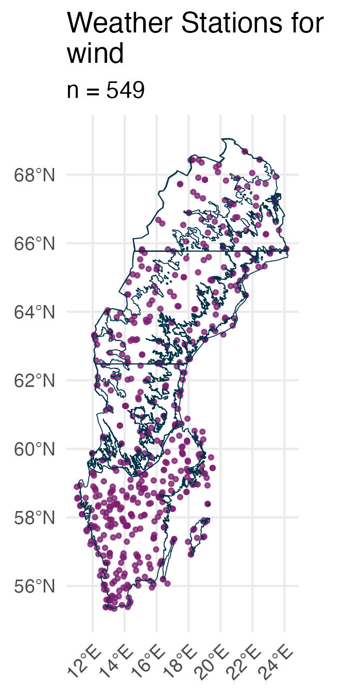
Weather Data
Collected from the Swedish Meteorological and Hydrological Institute (SMHI)
Open API for downloading weather station data
Air temperature (1hr), Precipitation intensity (mL / s), Wind, Snow-depth (1 day)…

Slide 8

Everything in a Spatial Database
Currently storing all data in a PostgreSQL database
Python functions to automatically collect data from SMHI
Loading of localisations and rasters using PostGIS
Automatically get covariates for each localisation
Can easily retrieve relevant data using dbplyr
Use in future projects

Slide 9
Methodology Overview
Defining moose strata
Defining extreme weather
How moose change movement and habitat selection

Slide 10
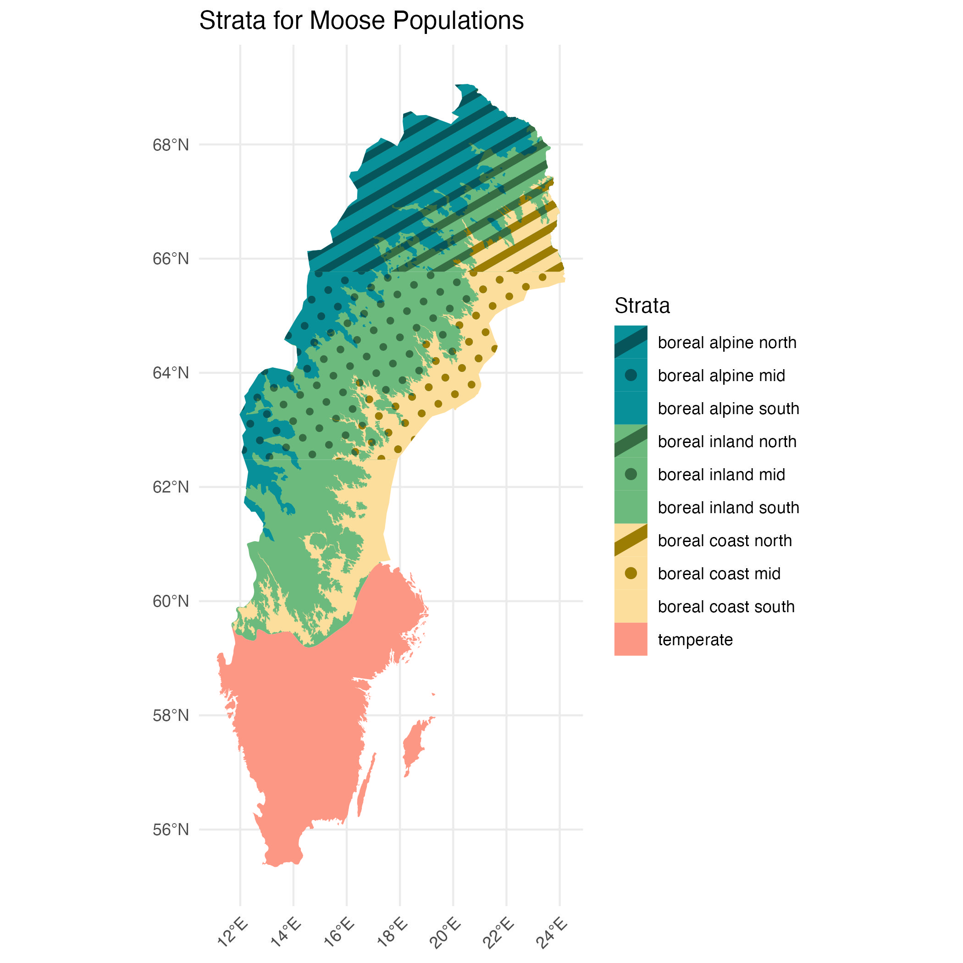
Strata
Considers differences per ecological zones
Tries to consider latitudinal differences
Split analysis for Winter/Summer (Græsli et al., 2020)
Using UN Global Ecological Zones, Coastal zones of SMHI, and the Mountain Forest Border of Swedish Forest Agency

Slide 11
What is Extreme Weather?
Initially considered climactic extreme (an unusually hot 6th of March)
Currently focussing on overall extreme (overal hottest days experienced by moose in each strata)
Can potentially be narrowed down later
Could help find “threshhold value”
Strata | Season | Mean | SD | Extreme - 95th Percentile
Boreal Inland North | Summer | 2.709994 | 2.02472 | 6.4
Boreal Inland North | Winter | 2.898357 | 3.068903 | 8.4

Slide 12
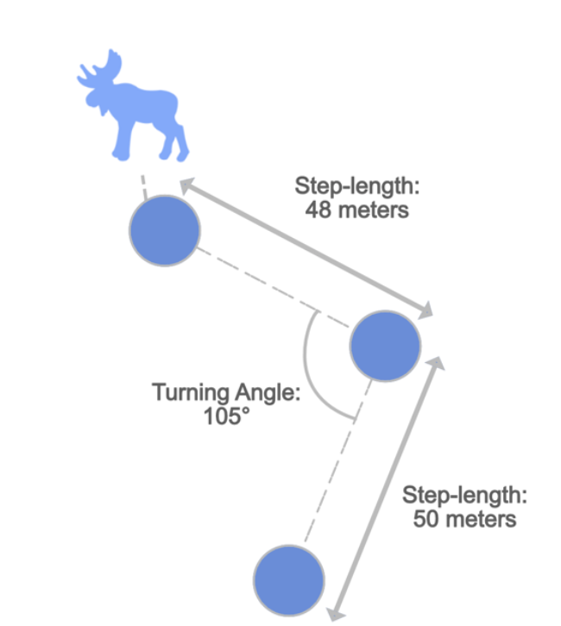
Observing Changes in Moose Movement
Analyse movement characteristics during extreme weather
Step length, turning angle
Compare to a week before
Will be used in habitat selection

Slide 13
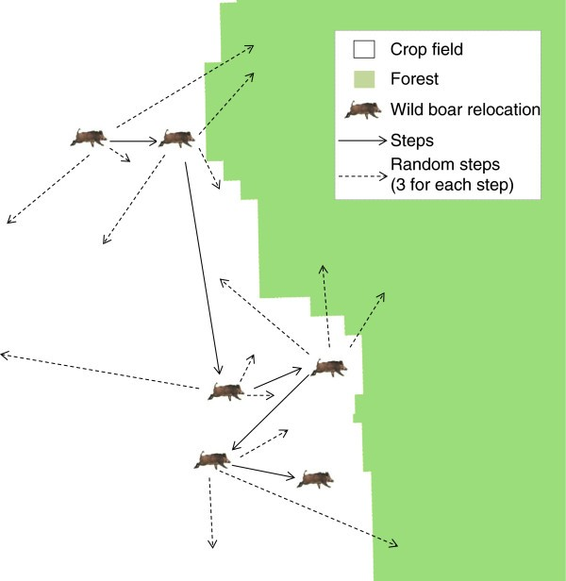
Observing Changes in Habitat Selection
Step selection functions
Take the extreme weather localisation
Take the localisation a week before (control)
Generate 5 random steps with covariates at both points
Conditional linear regression to see how covariates influence decisions
Notes:
each observed step is a ‘case’ associated with a set of ‘control’ (random) steps.

Slide 14
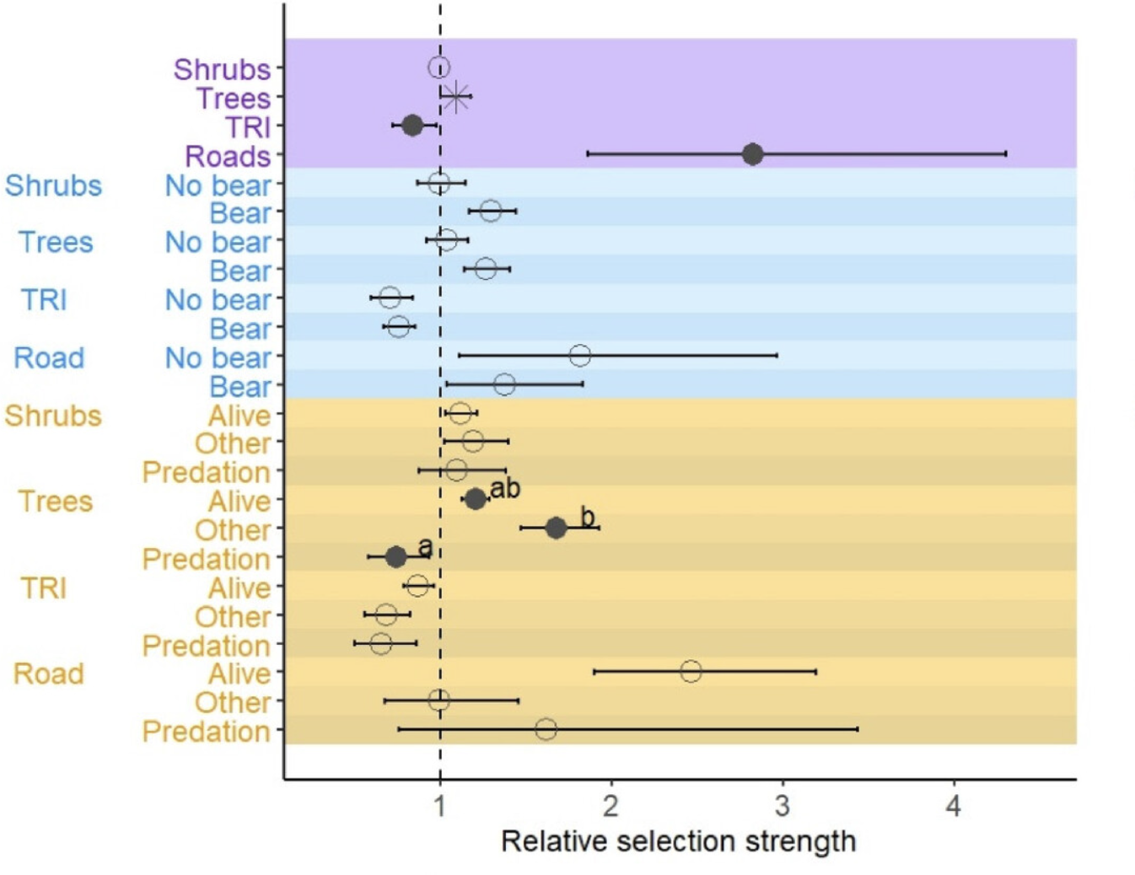
(Lisa et al., 2024)
Notes:
each observed step is a ‘case’ associated with a set of ‘control’ (random) steps.

